Slide 1
Television and Cable: The Power of Visual Culture
Chapter 6

Slide 2
Online Image Library
Go to www.bedfordstmartins.com/mediaculture/to access the Media & Culture, 9th Edition Online Image Library.
The library contains all your favorite images from Media & Culture, 9th edition!

Slide 3
The Convergence of Television
In the past, TV networks made or bought almost all TV shows, which aired at set times.
Today, original shows are also produced by cable channels and Internet services like Netflix and Hulu, and are frequently viewed days or weeks after the original air date.

Slide 4
Early Innovations in TV Technology
Cathode ray tube (late 1800s)
Combined principles of the camera and electricity
Scanning disk (1880s)
Developed by Paul Nipkow
Separated pictures into pinpoints of light that could be transmitted as a series of electronic lines

Slide 5
Electronic Technology: Zworykin and Farnsworth
RCA sued Farnsworth over Zworykin’s iconoscope patent.
Lost and had to license patents from Farnsworth
Analog standard adopted in 1941
Digital standard adopted in 2009
TV licensing freeze until 1952
RCA had the first successful color broadcast system in 1954

Slide 6
Controlling Content—TV Grows Up
Early television programs often had single sponsors.
Networks lacked creative control, so they made programs longer, which raised costs and forced advertisers out.
Two new types of programs helped networks gain control over content.
Magazine format
TV spectacular

Slide 7
Controlling Content—TV Grows Up (cont.)
Prime-time quiz shows
Cheap to produce, but rigged
Dropped by networks amid allegations of being fixed
Impact of the quiz show scandals
Ended sponsors’ role in creating content
Undermined Americans’ expectation of the democratic promise of television
Magnified the division of high and low culture attitudes toward television

Slide 8
CATV—Community Antenna Television
CATV
First small cable system
Originated where mountains or tall buildings blocked TV signals
Two big advantages
Eliminated over-the-air interference
Increased channel capacity

Slide 9
The Wires and Satellites behind Cable Television
Telstar launched in 1960
Discovery of how to lock satellites in geosynchronous orbit in the mid-1960s
How it works
Headend relays each channel along its own separate line
Signals delivered through trunk and feeder cables

Slide 10
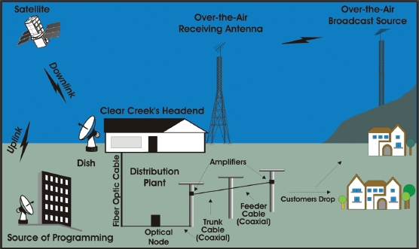
Figure 6.1: A Basic Cable Television System

Slide 11
Cable Services
Basic cable services
Hundred-plus channels
Local cable company pays each satellite-delivered service a per-subscriber fee.
Premium cable services
Premium channels such as HBO
Pay-per-view (PPV) channels
Video-on-demand (VOD) channels

Slide 12
DBS: Cable without Wires
Direct broadcast satellite (DBS) services
Transmit a signal directly to a satellite dish at customers’ homes
Reduced cable penetration
Began scrambling signals to prevent free access to broadcasts
Modern services include DirecTV and the DISH Network

Slide 13
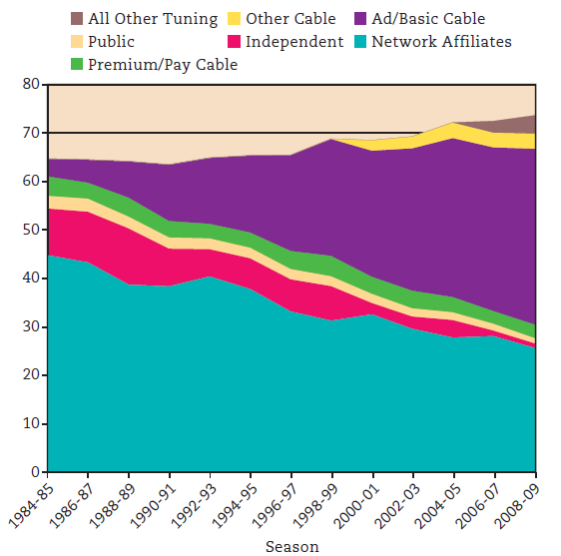
Figure 6.2: Prime-Time TV Audience, 1984-2009

Slide 14
Home Video
Videocassette recorders (VCRs)
Introduced in the mid-1970s
Federal court permitted home taping for personal use
Movie rentals became popular
Replaced by DVDs, which are being replaced by Blu-ray and DVRs
Two purposes of DVD and DVR
Video rentals and time shifting

Slide 15
The Third Screen: TV Converges with the Internet
Third screen
Refers to viewing content on computer screens
Used primarily as catch-up services
Popular sites for viewing video
YouTube, iTunes, Hulu, Netflix
Cable TV giants are also making programs available online.
Xfinity TV and HBO Go

Slide 16
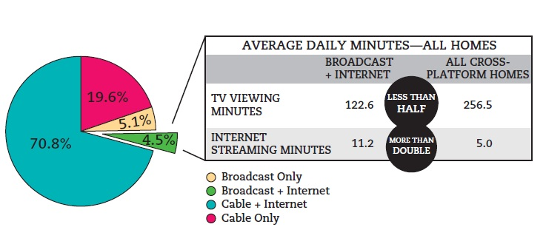
Figure 6.3: Cross-Platform Viewing

Slide 17
Fourth Screens: Smartphones and Mobile Video
Fourth-screen technology
Smartphones, iPods, iPads, and mobile TV devices
Forcing major changes in consumer viewing habits and media content creation
Multifunctionality and portability mean viewers may no longer need TV sets

Slide 18
TV Entertainment: Our Comic Culture
Networks move to Los Angeles in the 1950s.
Kinescopes were used to preserve live broadcasts.
Three TV comedy formats
Sketch comedy
Situation comedy
Domestic comedy

Slide 19
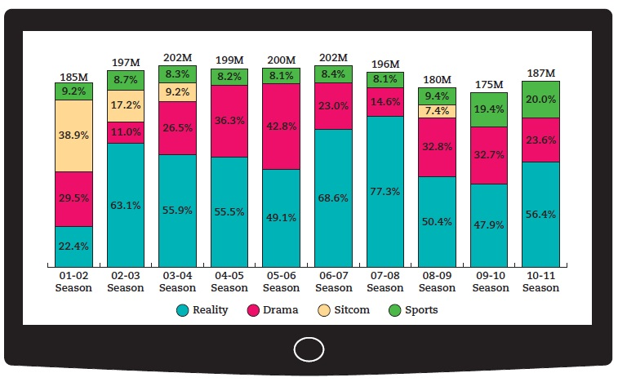
Figure 6.4: Top Genres Over the Past Decade

Slide 20
TV Entertainment: Our Dramatic Culture
Anthology drama
Brought live dramatic theater to the television audience
Ended for both economic and political reasons
Episodic series
Two general types
Chapter shows
Serial programs

Slide 21
TV Information: Our Daily News Culture
Network news
NBC’s Meet the Press (1947)
CBS-TV News (1948)
First news show to be videotaped for rebroadcast on affiliate stations (1956)
ABC World News Tonight (1978)
Cable news
First cable news channel was CNN
Created a 24/7 news cycle

Slide 22
Reality TV and Other Enduring Trends
Traditional genre trends
Talk shows, game shows, variety shows, newsmagazines, and sporting events
Reality TV
Introduces audiences to characters who are more like them
Inexpensive to produce
Spanish-language television

Slide 23
Public Television Struggles to Find Its Place
Public television
Public Broadcasting Act of 1967 leads to the establishment of PBS.
Targeted viewers that were “less attractive” to commercial networks
Increasing reliance on corporate underwriting
Government attempts to ax funding.
Audience has declined significantly.

Slide 24
Government Regulations Temporarily Restrict Network Control
Prime Time Access Rule (PTAR)
Reduced network control of prime-time programming to encourage more local programming
Fin-syn
Banned networks from reaping profits from program syndication
Department of Justice
Limited non-news programming

Slide 25
Balancing Cable’s Growth against Broadcasters’ Interests
Must-carry rules required cable operators to carry all local TV broadcasts.
FCC mandated access channels for the top 100 TV markets, along with leased channels.
Midwest Video case
Determined cable carriers were electronic publishers

Slide 26
Franchising Frenzy
Cable franchise
Mini-monopoly awarded by a local community to the most attractive bidder, usually for a 15-year period
Federal cable policy act from 1984 dictates the franchise fees for most U.S. municipalities.
Helps cities use such fees to establish and fund access channels

Slide 27
The Telecommunications Act of 1996
Telecommunications Act of 1996
Brought cable under federal rules that had long governed the telephone, radio, and TV industries
Removed market barriers between phone companies, long-distance carriers, and cable operators
Reaffirmed must-carry rules
Mixed impact on cable customers

Slide 28
Production
Two types of production costs
Below-the-line
Above-the-line
Programs are funded through deficit financing.
Film studios finance the deficit and hope to profit on syndication.
Less expensive programs
Newsmagazines and reality shows

Slide 29
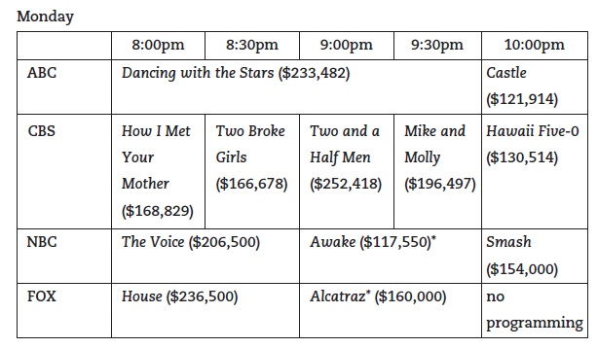
Figure 6.5: Prime-Time Network TV Pricing (2011)
Note: Figure 6.5 shows the average costs for a thirty-second commercial during prime-time programs, 2011.

Slide 30
Distribution
Paying for programs
Subscriber fees
Retransmission fees
Licensing fees to affiliate stations
Advertising
Clearance rules allow affiliates to substitute a network’s program.

Slide 31
Syndication Keeps Shows Going and Going…
Syndication
Leasing the exclusive right to air TV shows
Types
Off-network syndication
First-run syndication
Cash deal
Series goes to the highest bidder.
Barter deal
Syndicator is paid from ad revenue.

Slide 32
Measuring Television Viewing
Ratings and shares
Ratings are based on a percentage of households tuned to a sampled program.
Shares are based on a percentage of homes tuned to a program, compared with those actually using their sets at the time of sample.
Convergence is changing how TV viewing is measured.

Slide 33
Major Programming Corporations
Major broadcast networks
Remain attractive investments and are acquiring cable channels
Major cable and DBS companies
Multiple-system operators (MSOs)
Multichannel video programming distributors (MVPDs)
Comcast, DirecTV, and DISH Network are the major players

Slide 34
The Effects of Consolidation
Concern that the merging of telecommunications companies will limit expression and lead to price fixing
The industries respond that consolidation is necessary to buy up struggling companies to keep them afloat.

Slide 35
Alternative Voices
Some small cities are challenging cable giants by building publicly owned cable systems.
More than 2,000 such utilities now exist in the United States.
Nonprofit entities, so they are less expensive for cable subscribers

Slide 36
Television, Cable, and Democracy
In its heyday, television carried the promise that it could reach all segments of society.
Convergence potentially de-emphasizes the idea we are all citizens who are part of a larger nation and world.
TV is still a gathering place for friends and family.

