Slide 1
SWOT ANALYSIS
Overview and Examples: BA133

Slide 2
SWOT
Strengths: attributes of the person or company that are helpful to achieving the objective.
Weaknesses: attributes of the person or company that are harmful to achieving the objective. [Internal or external?]
Opportunities: external conditions that are helpful to achieving the objective.
Threats: external conditions which could do damage to the objective.

Slide 3
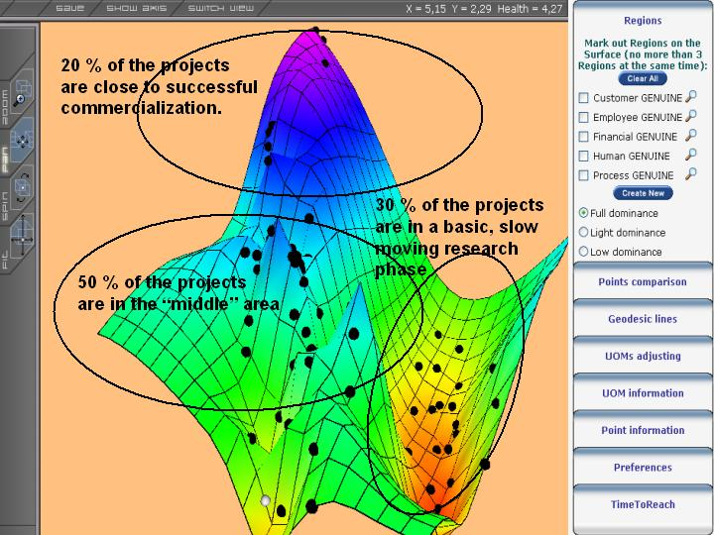
SWOT ‘Landscape’
Source: Wikipedia Commons

Slide 4
Strengths (partial list)
patents
strong brand name
good reputation among customers
cost advantages from proprietary know-how
exclusive access to high-grade natural resources
favorable access to distribution networks

Slide 5
Weaknesses
lack of patent protection
a weak brand name
poor reputation among customers
high cost structure
lack of access to the best natural resources
lack of access to key distribution channels

Slide 6
Opportunities
an unfulfilled customer need
arrival of new technologies
loosening of regulations
removal of international trade barriers

Slide 7
Threats
shifts in consumer tastes away from the firm's products
emergence of substitute products
new regulations
increased trade barriers

Slide 8
What about Non-Profits/Govt?
Discussion Example 1: WCU
In-Class:
Western Carolina University…

Slide 9
A Word, or Four, about ‘PEST’…
P
E
S
T
Which comes first, PEST or SWOT?

Slide 10
SWOT & Strategic Planning
How can we use and capitalize on each Strength?
How can we mitigate each Weakness?
How can we exploit and benefit from each Opportunity?
How can we diminish each Threat?

Slide 11
SWOT: Potential applications
a company (its position in the market, etc)
a method of sales distribution
a product or brand
a business idea
a strategic option (e.g., entering a new market or launching a new product)
a opportunity to make an acquisition
a potential partnership
changing a supplier
outsourcing a service, activity or resource
an investment opportunity

Slide 12
SWOT: Planning categories
Product [/Service] (what are we selling?)
Process (how are we selling it?)
Customer (to whom are we selling it?)
Distribution (how does it reach them?)
Finance (what are the prices, costs and investments?)
Administration (and how do we manage all this?)

Slide 13
Adjustments based on SWOT
Matching is used to find competitive advantages by matching the strengths to opportunities.
Converting is to apply conversion strategies to convert weaknesses or threats into strengths or opportunities.

Slide 14
Discussion Example 2: Toyota
The New York Times
Toyota’s Slow Awakening to a Deadly Problem
By Bill Vlasic
January 31, 2010

Slide 15
Discussion Example 3: iPad
Wired
Wondering Why You Can’t Pre-Order an iPad? It Isn’t Legal Yet
By Eliot Van Buskirk
January 29, 2010

Slide 16
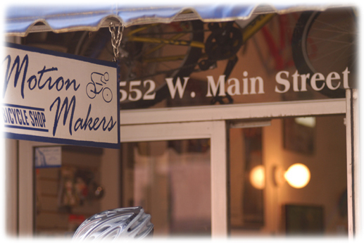
Discussion Example 4
Motion Makers Bicycle Shop (Sylva)
http://www.motionmakersbikes.com/

Slide 17
Discussion Example 5
Annie’s Naturally Bakery (Sylva)
http://www.anniesnaturallybakery.com/home.html

Slide 18
Hand In Assignment(s)
In-Class exercises today
Business case answers to Q1-Q11 on a ‘cool or innovative product or service’ (syllabus)
Five-Restaurant assignment (group) for Prof. Jones
Include your name and PROFESSOR’S NAME on each assignment

