Slide 1
Southern Sea Otters (Enhydra Lutris Nereis)
By: Lyndsey Burk, Michael Kuykendall, and Sara Downing

Slide 2
In 1938 scientists first noticed a decline in the southern sea otter population.
The otter population slowly increased until 1995 when the population peaked at 2,377.
When only 38 were still alive, they were placed on endangered species list.

Slide 3
Scientists had to find what was causing the otters to die out.
Autopsies revealed the main cause of the dying sea otters…
Toxoplasma Gondii

Slide 4
Our Hypothesis:
Toxoplasma gondii is the main cause of the Sea Otter population’s decline and the amount of pollution is proportional to the number of otter fatalities.
Were the otters were being poisoned by their food?

Slide 5
Toxoplasma Gondii
But how was this parasite commonly found in cat feces getting to the otters?
Is a parasitic protozoa carried in cats. The parasite affects the nervous system in otters, but was previously known to cause miscarriages in pregnant women.
The link between the otters and the toxoplasma gondii is in the sea otters’ diet.

Slide 6
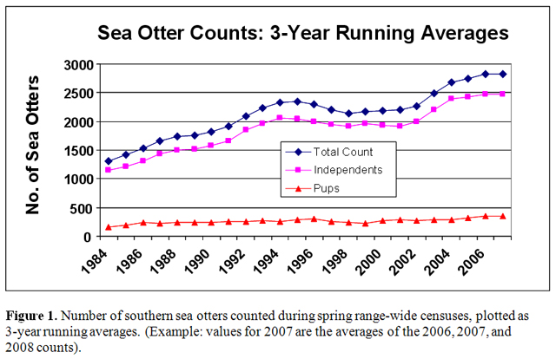
Pollution's Effect on Otter Populations
In 1990 there was a restriction placed on oil pollution in California, and the sea otter population benefited.
In this year pollution dropped again and the otter population was able to once again grow.
In this year the amount of pollution in the water increased dramatically.

Slide 7
How is the Toxoplasma gondii getting to the otters?
Dumping,
Water runoff, &
Natural events

Slide 8
Using mathematical models we can model the effects of pollution on the otter population.
The first mathematical model is called Vensim. Using information we know about the otters this program allows us to model the otter and shellfish populations and then predict how they will continue to grow or shrink.

Slide 10
(01) Baby Otters=
(Death By Otter/Shellfish needed to have otter pups)
Units: **undefined**
(02) Baby Shellfish=
(Polluted Shellfish+Unpolluted Shellfish)*Shellfish Birth Rate
Units: **undefined**
(03) Competition=
1e-005
Units: **undefined** [0,1e-005,1e-011]
(04) Dead Shellfish=
Shellfish Death Rate*Polluted Shellfish
Units: **undefined**
(05) Death By Otter=
Rate of Encounter 2*Unpolluted Shellfish*Otters
Units: **undefined**
(06) Death Rate=
0.005
Units: **undefined**
07) Dying Otters=
IF THEN ELSE(Pollution Switch Offecting Otters, Polluted Otter Food/Number of Shellfish that kills
,0)
Units: **undefined**
If pollution effects the otters death, then the number that die
is calculated by taking the number of polluted shellfish eaten
and dividing by the number of shellfish needed for an otter to
die. If pollution doesn't effect the otter death, then there are
0 dying otters through this pipe.
(08) Dying Shellfish=
Shellfish Death Rate*Unpolluted Shellfish
Units: **undefined**
(09) FINAL TIME = 3000
Units: Month
The final time for the simulation.
(10) Getting Polluted=
Rate of Pollution*Unpolluted Shellfish
Units: **undefined**
(11) INITIAL TIME = 0
Units: Month
The initial time for the simulation.
(12) Natural Death=
Death Rate*Otters+Competition*Otters*Otters
Units: **undefined**
(13) Number of Shellfish that kills=
1100
Units: **undefined**
(14) Otters= INTEG (
Baby Otters-Dying Otters-Natural Death,
30)
Units: **undefined**
(15) Percent Otters Dying By Pollution=
Dying Otters/(Dying Otters+Natural Death)*100
Units: **undefined**
(16) Percent Polluted Shellfish=
Polluted Shellfish/(Polluted Shellfish+Unpolluted Shellfish)*100
Units: **undefined**
(17) Polluted Otter Food=
Otters*Polluted Shellfish*Rate of Encounter 1
Units: **undefined**
(18) Polluted Shellfish= INTEG (
Getting Polluted-Dead Shellfish-Polluted Otter Food,
50)
Units: **undefined**
(19) Pollution Switch Offecting Otters=
1
Units: **undefined**
If this value is 0, then it's false that pollution will effect
the otters. If it's 1, then it's true that pollution will effect
the otters.
(20) Rate of Encounter 1=
1e-006
Units: **undefined**
(21) Rate of Encounter 2=
Rate of Encounter 1
Units: **undefined** [0,1e-007,1e-010]
22) Rate of Pollution=
0.025
Units: **undefined**
(23) SAVEPER =
TIME STEP
Units: Month [0,?]
The frequency with which output is stored.
(24) Shellfish Birth Rate=
0.008
Units: **undefined**
(25) Shellfish Death Rate=
0.001
Units: **undefined**
(26) Shellfish needed to have otter pups=
100
Units: **undefined**
(27) TIME STEP = 0.5
Units: Month [0,?]
The time step for the simulation.
(28) Unpolluted Shellfish= INTEG (
Baby Shellfish-Death By Otter-Dying Shellfish-Getting Polluted,
1e+006)
Units: **undefined**

Slide 12
This next mathematical model is called Netlogo. This model does what the Vensim model does but it also gives a visual picture of the populations.

Slide 13
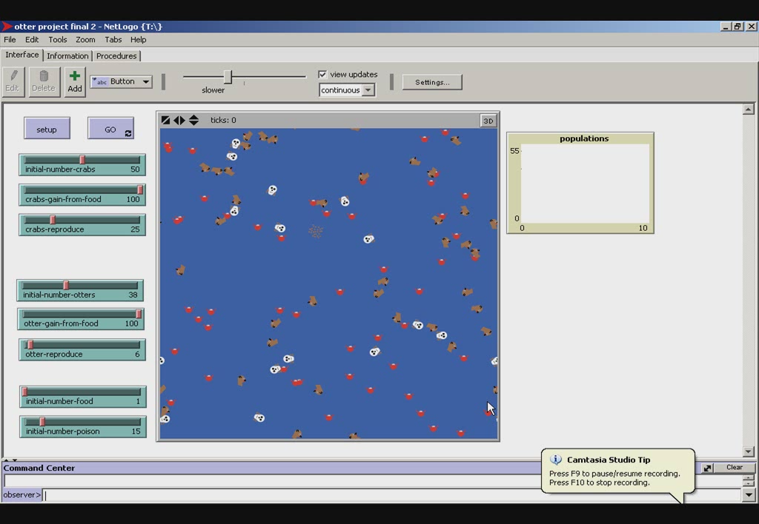

Slide 14
Red = shellfish
Brown = otters

Slide 15
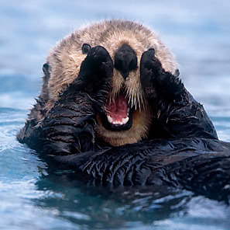
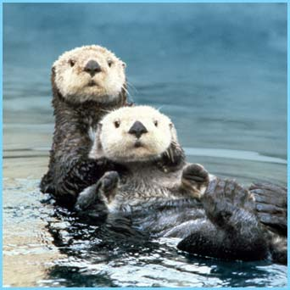
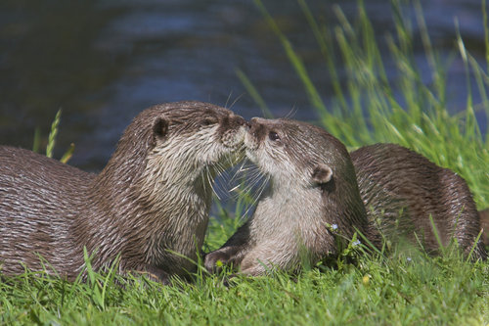
According to these models if the pollution continues the otters will eventually die out. Last year alone there was an 8.8% drop in the southern sea otters’ population.
And who
could kill
THE END
these cute little creatures?

Slide 16
Southern Sea Otter Sources
http://www.nmfs.noaa.gov/pr/pdfs/sars/fws2000_seaotter-ca.pdf
7/3/07
http://www.seaotters.org/PastActions/index.cfm?DocID=181
7/3/08
http://scholar.lib.vt.edu/theses/available/etd-05222002-145125/unrestricted/JodiDewThesis.pdf
7/3/08
www.seaotter-sealion.org/seaotter/factsseaotter.html
7/3/08
http://www.ci.seaside.ca.us/pw%5Carpt%5C92907%5CMRSWMP%20Draft%20Annual%20Report%20Appendix%20M%209-26-07.pdf
7/3/08
Biological and Molecular Characterizations of Toxoplasma gondii Strains Obtained from Southern Sea Otters (Enhydra lutris nereis) (jstor)
Author(s): R.A. Cole, D.S. Lindsay, D.K. Howe, C.L. Roderick, J.P. Dubey, N.J. Thomas, L.A. Baeten
Source: The Journal of Parasitology, Vol. 86, No. 3 (Jun., 2000), pp. 526-530
7/1/08

Slide 17
http://endangered-species.suite101.com/article.cfm/sea_otters_and_marine_pollution
7/1/08
http://www.sfgate.com/cgi-bin/article.cgi?f=/c/a/2003/05/07/MN178297.DTL
7/1/08
http://www.defenders.org/newsroom/press_releases_folder/2006/9_18_2006_sea_otter_bill_signed.php
7/1/08
Removal of Toxoplasma gondii oocysts from sea water by eastern oysters (Crassostrea virginica)
Author(s): Lindsay DS, Phelps KK, Smith SA, Flick G, Sumner SS, Dubey JP
Source: JOURNAL OF EUKARYOTIC MICROBIOLOGY Pages: 197S-198S Supplement: Suppl. S Published: 2001
7/2/08
Survival of Toxoplasma gondii oocysts Eastern oysters (Crassostrea virginica)
Author(s): Lindsay DS, Collins MV, Mitchell SM, Wetch CN, Rosypal AC, Flick GJ, Zajac AM, Lindquist A, Dubey JR
Source: JOURNAL OF PARASITOLOGY Volume: 90 Issue: 5 Pages: 1054-1057 Published: OCT 2004
7/2/08

Slide 18
Transmission of Toxoplasma: Clues from the study of sea otters as sentinels of Toxoplasma gondii flow into the marine environment
Author(s): Conrad PA, Miller MA, Kreuder C, James ER, Mazet J, Dabritz H, Jessup DA, Gulland F, Grigg ME
Source: INTERNATIONAL JOURNAL FOR PARASITOLOGY Volume: 35 Issue: 11-12 Pages: 1155-1168 Published: OCT 2005
7/2/08
http://www.travelkamchatka.com/images/seaotter.jpg
7/4/08
http://images.dpchallenge.com/images_portfolio/12578/print_preview/365019.jpg
7/4/08
http://olympiccoast.noaa.gov/images/bodypic_ocdc2_lg.jpg
7/4/08
Brian Hatfield (personal contact)
www.werc.usgs.gov/otters/ca-surveys.html
6/30/08

